Slide 1
DETERMINAN
Minor, Kofaktor, Determinan, Singular, Nonsingular, Rank,
Adjoint Matriks, Invers Matriks

Slide 2
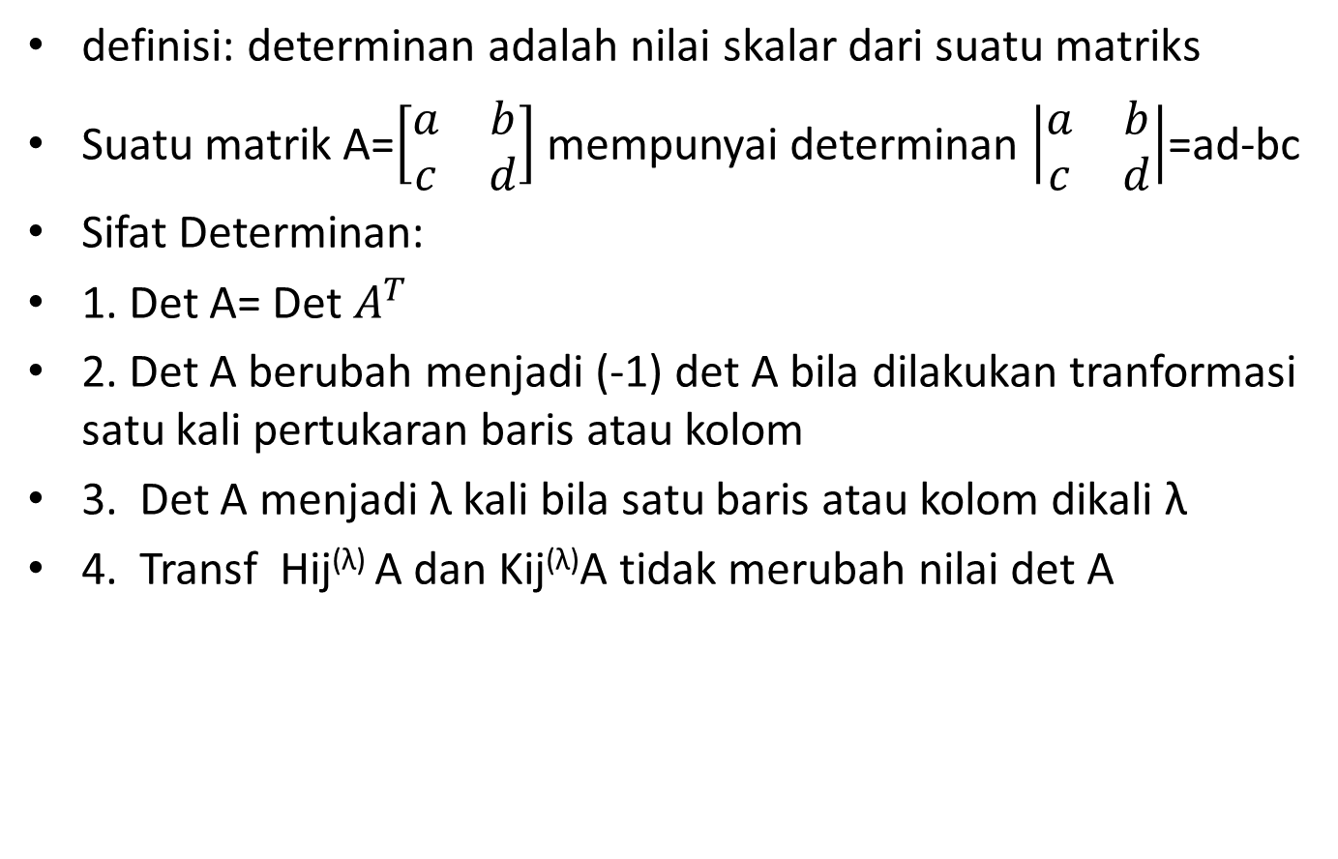
a. Determinan

Slide 3
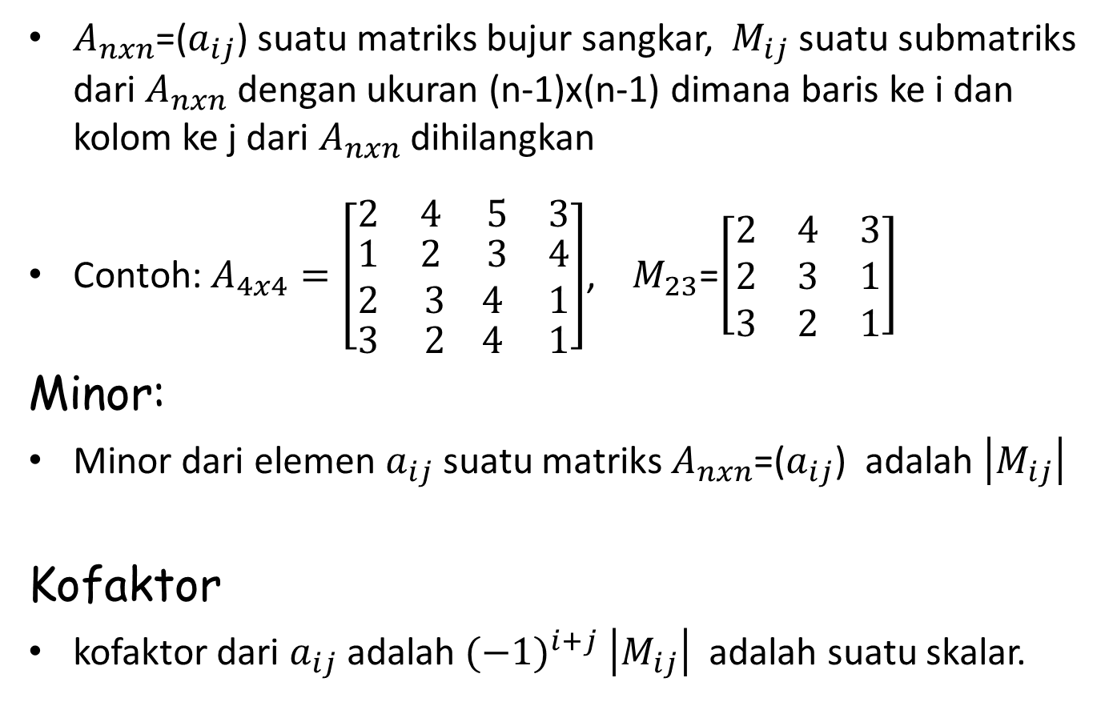
b. Minor dan Kofaktor
$A_{nxn}$=($a_{ij}$) suatu matriks bujur sangkar, ${ M}_{ij}$ suatu submatriks dari $A_{nxn}$ dengan ukuran (n-1)x(n-1) dimana baris ke i dan kolom ke j dari $A_{nxn}$ dihilangkan
Contoh: $A_{4x4}=\left[\begin{matrix}2 & 4 5 & 3 \\ \begin{aligned}1 \\ 2\end{aligned} & \begin{aligned}2 3 \\ 3 4\end{aligned} & \begin{aligned}4 \\ 1\end{aligned} \\ 3 & 2 4 & 1\end{matrix}\right]$, $M_{23}$=$\left[\begin{matrix}2 & 4 & 3 \\ 2 & 3 & 1 \\ 3 & 2 & 1\end{matrix}\right]$
Minor:
Minor dari elemen $a_{ij}$ suatu matriks $A_{nxn}$=($a_{ij}$) adalah $\left|M_{ij}\right|$
Kofaktor
kofaktor dari $a_{ij}$ adalah ${(−1)}^{i+j}$ $\left|M_{ij}\right|$ adalah suatu skalar.

Slide 4
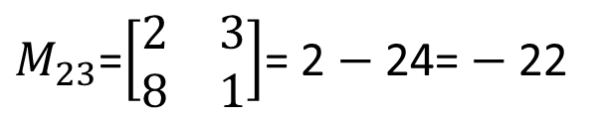

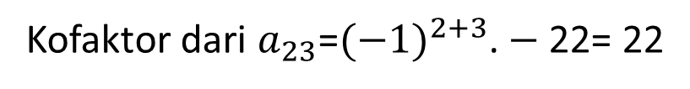
Contoh:
$A_{3x3}=\left[\begin{matrix}2 & 3 & 4 \\ 5 & 6 & 7 \\ 8 & 1 & 9\end{matrix}\right]$,
$M_{23}$=$\left[\begin{matrix}2 & 3 \\ 8 & 1\end{matrix}\right]$= 2 $−$24= $−$22
Kofaktor dari $a_{23}$=${(−1)}^{2+3}$. $−$22= 22

Slide 5
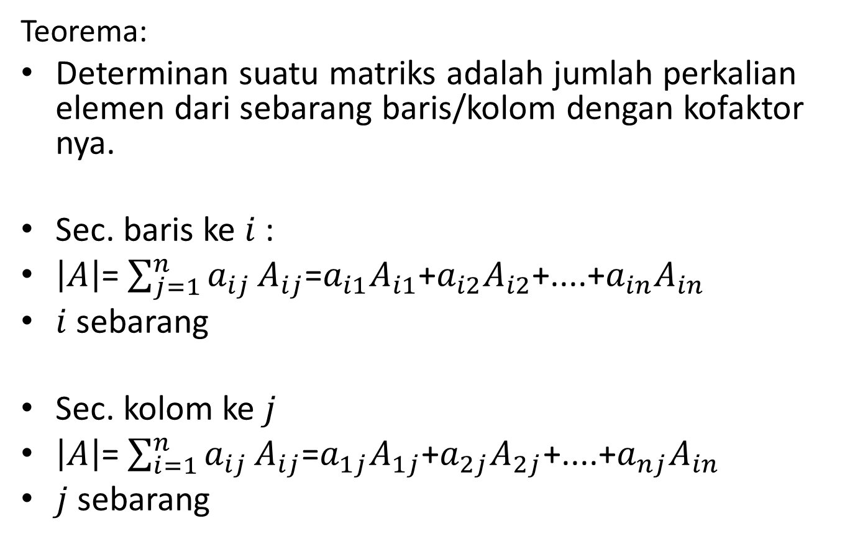
c. Ekspansi secara baris dan kolom
Teorema:
Determinan suatu matriks adalah jumlah perkalian elemen dari sebarang baris/kolom dengan kofaktor nya.
Sec. baris ke $i$:
$\left|A\right|$= $\sum_{j=1}^{n}{a_{ij}}A_{ij}$=$a_{i1}A_{i1}$+$a_{i2}A_{i2}$+....+$a_{in}A_{in}$
$i$ sebarang
Sec. kolom ke $j$
$\left|A\right|$= $\sum_{i=1}^{n}{a_{ij}}A_{ij}$=$a_{1j}A_{1j}$+$a_{2j}A_{2j}$+....+$a_{nj}A_{in}$
$j$ sebarang

Slide 6
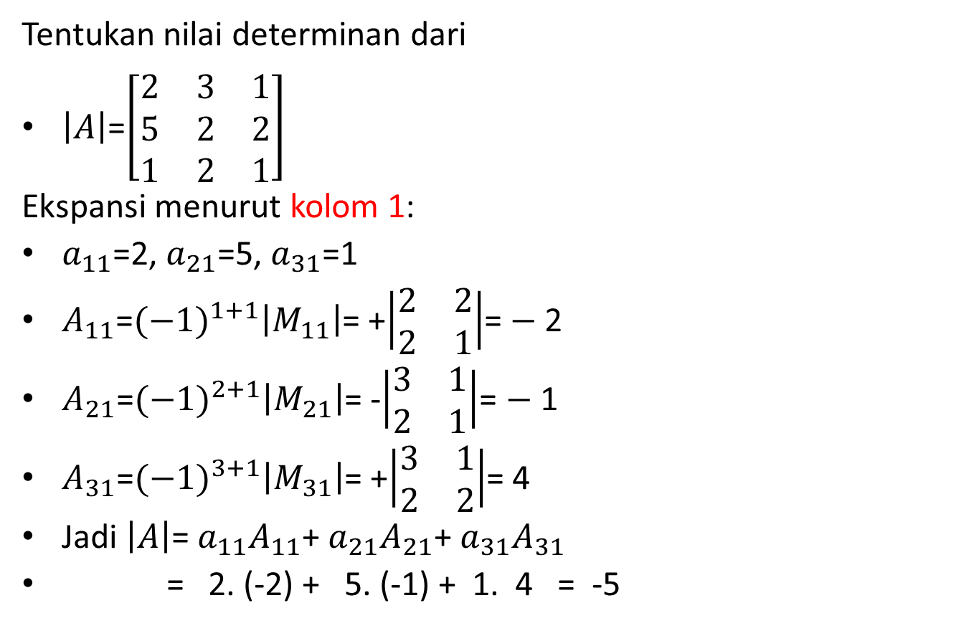
Contoh:
Tentukan nilai determinan dari
$\left|A\right|$=$\left[\begin{matrix}2 & 3 & 1 \\ 5 & 2 & 2 \\ 1 & 2 & 1\end{matrix}\right]$
Ekspansi menurut kolom 1:
$a_{11}$=2, $a_{21}$=5, $a_{31}$=1
$A_{11}$=${(−1)}^{1+1}\left|M_{11}\right|$= +$\left|\begin{matrix}2 & 2 \\ 2 & 1\end{matrix}\right|$= $−$2
$A_{21}$=${(−1)}^{2+1}\left|M_{21}\right|$= -$\left|\begin{matrix}3 & 1 \\ 2 & 1\end{matrix}\right|$= $−$1
$A_{31}$=${(−1)}^{3+1}\left|M_{31}\right|$= +$\left|\begin{matrix}3 & 1 \\ 2 & 2\end{matrix}\right|$= 4
Jadi $\left|A\right|$= $a_{11}A_{11}$+ $a_{21}A_{21}$+ $a_{31}A_{31}$
= 2. (-2) + 5. (-1) + 1. 4 = -5

Slide 7

Contoh:
Tentukan nilai determinan dari
$\left|A\right|$=$\left[\begin{matrix}2 & 3 & 1 \\ 5 & 2 & 2 \\ 1 & 2 & 1\end{matrix}\right]$
Ekspansi menurut kolom 3:
$a_{13}$=1, $a_{23}$=2, $a_{33}$=1
$A_{13}$=${(−1)}^{1+3}\left|M_{13}\right|$= +$\left|\begin{matrix}5 & 2 \\ 1 & 2\end{matrix}\right|$= $8$
$A_{23}$=${(−1)}^{2+3}\left|M_{23}\right|$= -$\left|\begin{matrix}2 & 3 \\ 1 & 2\end{matrix}\right|$=-1
$A_{33}$=${(−1)}^{3+3}\left|M_{33}\right|$= +$\left|\begin{matrix}2 & 3 \\ 5 & 2\end{matrix}\right|$= -11
Jadi $\left|A\right|$= $a_{13}A_{13}$+ $a_{23}A_{23}$+ $a_{33}A_{33}$
= 1. (8) + 2. (-1) + 1. (-11) = -5

Slide 8


Contoh2:
$\left|A\right|$=$\left[\begin{matrix}1 & −2 & 3 \\ 4 & −2 & 3 \\ 2 & 5 & −1\end{matrix}\right]$
Ekspansi menurut baris 2:
$a_{21}$= 4, $a_{22}$= $−$2, ${ a}_{23}$= 3
$A_{21}$=${(−1)}^{2+1}\left|M_{21}\right|$= $− \left|\begin{matrix}−2 & 3 \\ 5 & −1\end{matrix}\right|$= 13
$A_{22}$=${(−1)}^{2+2}\left|M_{22}\right|$= $+\left|\begin{matrix}1 & 3 \\ 2 & −1\end{matrix}\right|$= $−$7
$A_{23}$=${(−1)}^{2+3}\left|M_{23}\right|$= $− \left|\begin{matrix}1 & −2 \\ 2 & 5\end{matrix}\right|$= $−$9
Jadi $\left|A\right|$ = $a_{21}A_{21}$+ $a_{22}A_{22}$+ $a_{23}A_{23}$
= 4.(13) +(-2).(-7) +3.(-9) = 39
$\left|A\right|$= $−$4.$\left|\begin{matrix}−2 & 3 \\ 5 & −1\end{matrix}\right|$+ $(−2)\text{.}\left|\begin{matrix}1 & 3 \\ 2 & −1\end{matrix}\right|$ $− 3\left|\begin{matrix}1 & −2 \\ 2 & 5\end{matrix}\right|$= 39

Slide 9

Contoh2:
$\left|A\right|$=$\left[\begin{matrix}1 & −2 & 3 \\ 4 & −2 & 3 \\ 2 & 5 & −1\end{matrix}\right]$
Ekspansi menurut kolom 1:
$a_{11}$= 1, $a_{21}$= $4$, ${ a}_{31}$= 2
$A_{11}$=${(−1)}^{1+1}\left|M_{11}\right|$= $+ \left|\begin{matrix}−2 & 3 \\ 5 & −1\end{matrix}\right|$= -13
$A_{21}$=${(−1)}^{2+1}\left|M_{21}\right|$= $−\left|\begin{matrix}−2 & 3 \\ 5 & −1\end{matrix}\right|$= $13$
$A_{31}$=${(−1)}^{3+1}\left|M_{31}\right|$= $+ \left|\begin{matrix}−2 & 3 \\ −2 & 3\end{matrix}\right|$= $0$
Jadi $\left|A\right|$ = $a_{11}A_{11}$+ $a_{21}A_{21}$+ $a_{31}A_{31}$
= 1.(-13) +4.(13) +2.(0) = 39 atau
$\left|A\right|$= $1$.$\left|\begin{matrix}−2 & 3 \\ 5 & −1\end{matrix}\right|$+ $4\text{.}\left|\begin{matrix}−2 & 3 \\ 5 & −1\end{matrix}\right|$ $−2.\left|\begin{matrix}−2 & 3 \\ −2 & 3\end{matrix}\right|$= 39

Slide 10
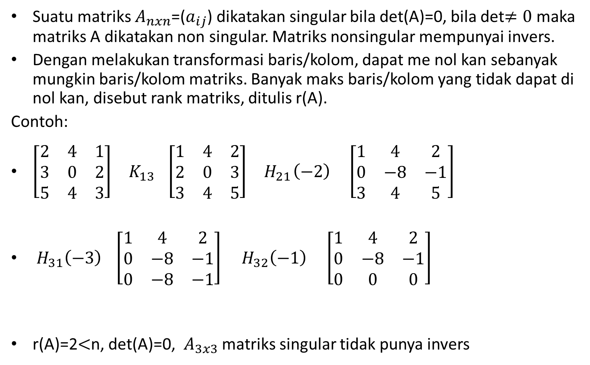
d. Matriks singular, non singular, dan rank
Suatu matriks $A_{nxn}$=($a_{ij}$) dikatakan singular bila det(A)=0, bila det$≠0$ maka matriks A dikatakan non singular. Matriks nonsingular mempunyai invers.
Dengan melakukan transformasi baris/kolom, dapat me nol kan sebanyak mungkin baris/kolom matriks. Banyak maks baris/kolom yang tidak dapat di nol kan, disebut rank matriks, ditulis r(A).
Contoh:
$\left[\begin{matrix}2 & 4 & 1 \\ 3 & 0 & 2 \\ 5 & 4 & 3\end{matrix}\right]{ K}_{13} \left[\begin{matrix}1 & 4 & 2 \\ 2 & 0 & 3 \\ 3 & 4 & 5\end{matrix}\right]{ H}_{21}\left(−2\right) \left[\begin{matrix}1 & 4 & 2 \\ 0 & −8 & −1 \\ 3 & 4 & 5\end{matrix}\right]$
$H_{31}\left(−3\right) \left[\begin{matrix}1 & 4 & 2 \\ 0 & −8 & −1 \\ 0 & −8 & −1\end{matrix}\right]$ ${ H}_{32}\left(−1\right)$ $\left[\begin{matrix}1 & 4 & 2 \\ 0 & −8 & −1 \\ 0 & 0 & 0\end{matrix}\right]$
r(A)=2$<$n, det(A)=0, $A_{3x3}$ matriks singular tidak punya invers

Slide 11
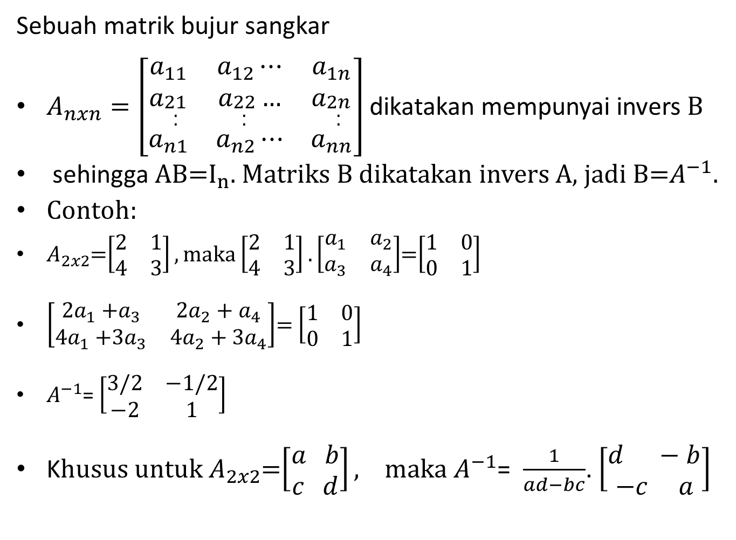
e. Matriks Invers
Sebuah matrik bujur sangkar
$A_{nxn}=\left[\begin{matrix}a_{11} & a_{12}⋯ & a_{1n} \\ a_{\begin{aligned}21 \\ . \\ .\end{aligned}} & a_{\begin{aligned}22 \\ . \\ .\end{aligned}}… & a_{\begin{aligned}2n \\ . \\ .\end{aligned}} \\ a_{n1} & a_{n2}⋯ & a_{nn}\end{matrix}\right]$ dikatakan mempunyai invers B
sehingga AB=$I_{n}$. Matriks B dikatakan invers A, jadi B=$A^{−1}$.
Contoh:
$A_{2x2}$=$\left[\begin{matrix}2 & 1 \\ 4 & 3\end{matrix}\right], maka$ $\left[\begin{matrix}2 & 1 \\ 4 & 3\end{matrix}\right].\left[\begin{matrix}a_{1} & a_{2} \\ a_{3} & a_{4}\end{matrix}\right]$=$\left[\begin{matrix}1 & 0 \\ 0 & 1\end{matrix}\right]$
$\left[\begin{matrix}{2a}_{1}{+a}_{3} & {2a}_{2}+a_{4} \\ {4a}_{1}{+3a}_{3} & {4a}_{2}+{3a}_{4}\end{matrix}\right]$= $\left[\begin{matrix}1 & 0 \\ 0 & 1\end{matrix}\right]$
$A^{−1}$= $\left[\begin{matrix}3/2 & −1/2 \\ −2 & 1\end{matrix}\right]$
K$husus untuk A_{2x2}$=$\left[\begin{aligned}a b \\ c d\end{aligned}\right], maka A^{−1}$= $\frac{1}{ad−bc}$. $\left[\begin{aligned}d −b \\ −c a\end{aligned}\right]$

Slide 12
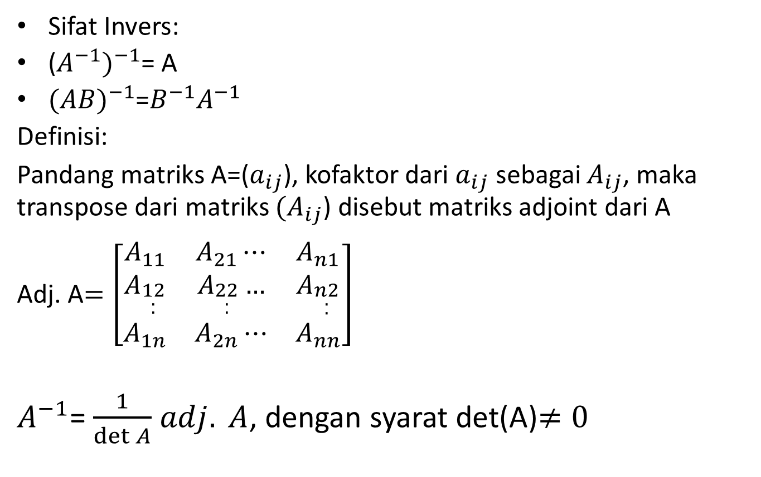
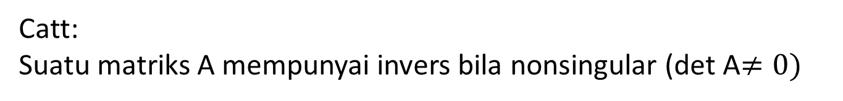
Catt: Suatu matriks A mempunyai invers bila nonsingular (det A$≠0)$
Sifat Invers:
($A^{−1})^{−1}$= A
${(AB)}^{−1}$=$B^{−1}A^{−1}$
Definisi:
Pandang matriks A=($a_{ij}$), kofaktor dari $a_{ij}$ sebagai $A_{ij}$, maka transpose dari matriks ${(A}_{ij}$) disebut matriks adjoint dari A
Adj. A$=\left[\begin{matrix}A_{11} & A_{21}⋯ & A_{n1} \\ A_{\begin{aligned}12 \\ . \\ .\end{aligned}} & A_{\begin{aligned}22 \\ . \\ .\end{aligned}}… & A_{\begin{aligned}n2 \\ . \\ .\end{aligned}} \\ A_{1n} & A_{2n}⋯ & A_{nn}\end{matrix}\right]$
$A^{−1}$= $\frac{1}{\det{A}}$ $adj. A$, dengan syarat det(A)$≠0$

Slide 13

Contoh: Menentukan Adjoint A
A=$\left[\begin{matrix}1 & 2 & 3 \\ 1 & 3 & 3 \\ 1 & 2 & 4\end{matrix}\right], kofaktor nya$
$A_{11}$=+$\left|\begin{matrix}3 & 3 \\ 2 & 4\end{matrix}\right|$= $6$, $A_{12}$= $− \left|\begin{matrix}1 & 3 \\ 1 & 4\end{matrix}\right|$= -1, $A_{13}$=+$\left|\begin{matrix}1 & 3 \\ 1 & 2\end{matrix}\right|$=- 1,
$A_{21}$= $− \left|\begin{matrix}2 & 3 \\ 2 & 4\end{matrix}\right|$= $−2$, $A_{22}$=+$\left|\begin{matrix}1 & 3 \\ 1 & 4\end{matrix}\right|$= 1, $A_{23}$= $− \left|\begin{matrix}1 & 2 \\ 1 & 2\end{matrix}\right|$= 0
$A_{31}$=+$\left|\begin{matrix}2 & 3 \\ 3 & 3\end{matrix}\right|$= $−3$, $A_{32}$= $− \left|\begin{matrix}1 & 3 \\ 1 & 3\end{matrix}\right|$= $0$, $A_{33}$= $+ \left|\begin{matrix}1 & 2 \\ 1 & 3\end{matrix}\right|$= $1$
Matriks kofaktor A= $\left[\begin{matrix}6 & −1 & −1 \\ −2 & 1 & 0 \\ −3 & 0 & 1\end{matrix}\right]$
Adjoint A = $\left[\begin{matrix}6 & −2 & −3 \\ −1 & 1 & 0 \\ −1 & 0 & 1\end{matrix}\right]$

Slide 14

Menentukan Invers Matrik A
det$\left[\begin{matrix}1 & 2 & 3 \\ 1 & 3 & 3 \\ 1 & 2 & 4\end{matrix}\right]=+1.\left|\begin{matrix}3 & 3 \\ 2 & 4\end{matrix}\right|−$ 1. $\left|\begin{matrix}2 & 3 \\ 2 & 4\end{matrix}\right|$+ 1.$\left|\begin{matrix}2 & 3 \\ 3 & 3\end{matrix}\right|$
= $6−$2 $−$3= $1$
$A^{−1}$= $\frac{1}{\det{A}}$ $adj. A =\frac{1}{1}$ .$\left[\begin{matrix}6 & −2 & −3 \\ −1 & 1 & 0 \\ −1 & 0 & 1\end{matrix}\right]$=
$A^{−1}$= $\left[\begin{matrix}6 & −2 & −3 \\ −1 & 1 & 0 \\ −1 & 0 & 1\end{matrix}\right]$

